Slide 1
Crop rotation schedular
Harshitha rollno 25A31A05BM
Amrutha rollno 25A31A05CG
Tejaswi rollno 25A31A05cm
Raja rollno 25A31A05BM
Under the guidance of manas sir

Slide 2
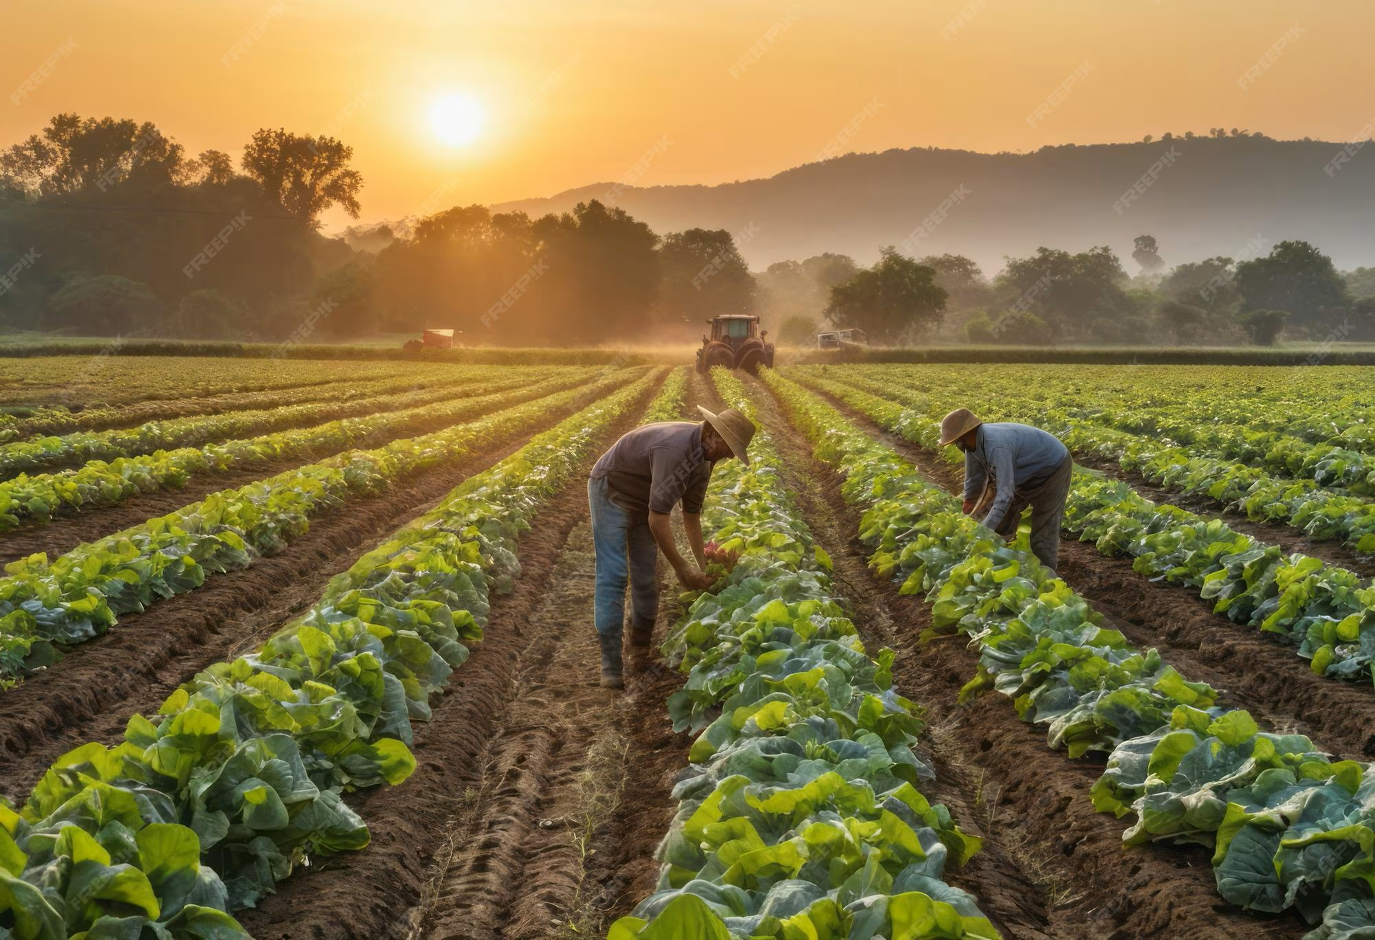
Definition
Crop rotation is the practice of growing different crops in a planned sequence on the same land. A scheduler helps in planning which crop to grow and when.

Slide 3

Need for Crop Rotation
Crop rotation is important because it helps maintain soil fertility, prevents nutrient depletion, and improves soil structure. It controls pests, diseases, and weeds by breaking their life cycles. It also increases crop yield, ensures better use of resources, and supports environmentally sustainable farming.

Slide 4
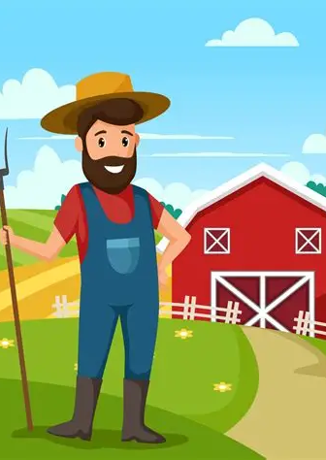
Principles of Crop Rotation
Grow different crops in a sequence instead of the same crop repeatedly.
Alternate deep-rooted and shallow-rooted crops.
Include leguminous crops to improve soil fertility (nitrogen fixation).
Rotate crops with different nutrient requirements. Avoid growing crops of the same family consecutively.
Follow crops that help control pests, diseases, and weeds.
Maintain a proper balance between soil-improving and soil-exhausting crops.

Slide 5
INPUTS TAKEN BY THE C++ PROGRAM
Season: Kharif, Rabi or Zaid
Soil: Black, Red, Alluvial or Sandy
Previous crop: Rice, Wheat, Maize, Cotton, Groundnut or Pulses
Expected rainfall: entered in millimetres (mm)
6

Slide 6
RECOMMENDATION LOGIC USED IN THE CODE
Rice → Pulses when rainfall is above 700 mm; otherwise Groundnut.
Wheat → Cotton for Black Soil; otherwise Maize.
Maize → Soybean.
Cotton → Wheat in Rabi; otherwise Pulses.
Groundnut → Wheat.
Pulses → Rice when rainfall is above 700 mm; otherwise Maize.
7

Slide 7
SYSTEM FLOW
1. Select Season
2. Select Soil Type
3. Select Previous Crop
4. Enter Rainfall
5. Apply if/else Rules
6. Display Recommendation
8

Slide 8
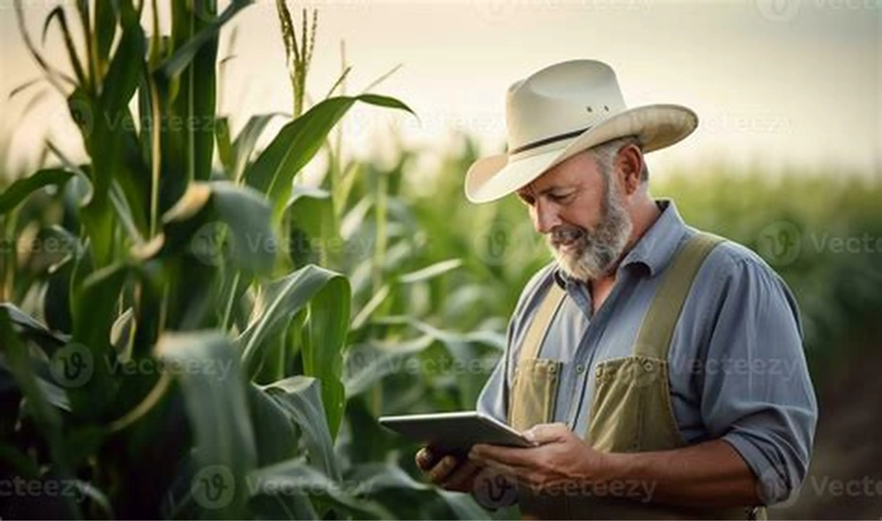
Advantages of Crop Rotation Scheduler
Improves soil fertility and maintains nutrient balance
Increases crop yield and productivity
Reduces pests and diseases naturally
Controls weed growth effectively
Enhances soil structure and health
Ensures efficient use of water and resources

Slide 9
CURRENT LIMITATIONS
The recommendations are based on simple fixed rules.
The program does not use live weather or soil sensor data.
It does not calculate exact yield or profit.
Real farm decisions should consider local agricultural conditions and expert advice.
12

Slide 10
FUTURE ENHANCEMENTS
Add soil-moisture, temperature and other sensors.
Connect the program to a crop database.
Add a GUI or web/mobile application.
Include irrigation and fertilizer recommendations.
Use real agricultural datasets to improve recommendations.
13

Slide 11
CONCLUSION
The project demonstrates how C++ can solve a simple real-world agriculture problem.
It takes four basic inputs and applies crop-rotation rules.
The system gives a recommended next crop along with a reason.
It provides a strong beginner foundation for a more advanced smart farming system.
14

Slide 12
THANK YOU
Questions?
15

